Slide 1
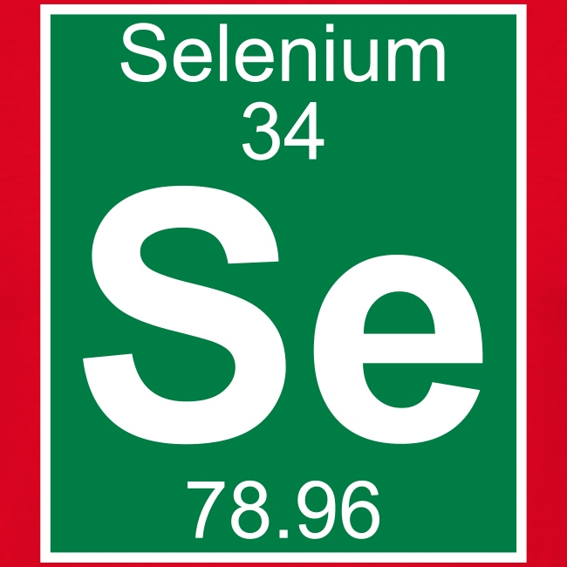
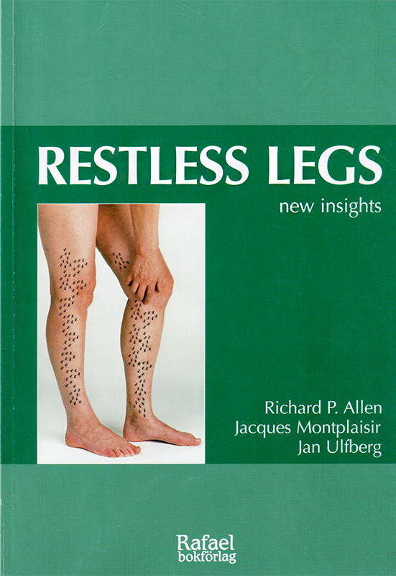
Selenium in RLS/WED
Jan Ulfberg, MD, PhD

Slide 2
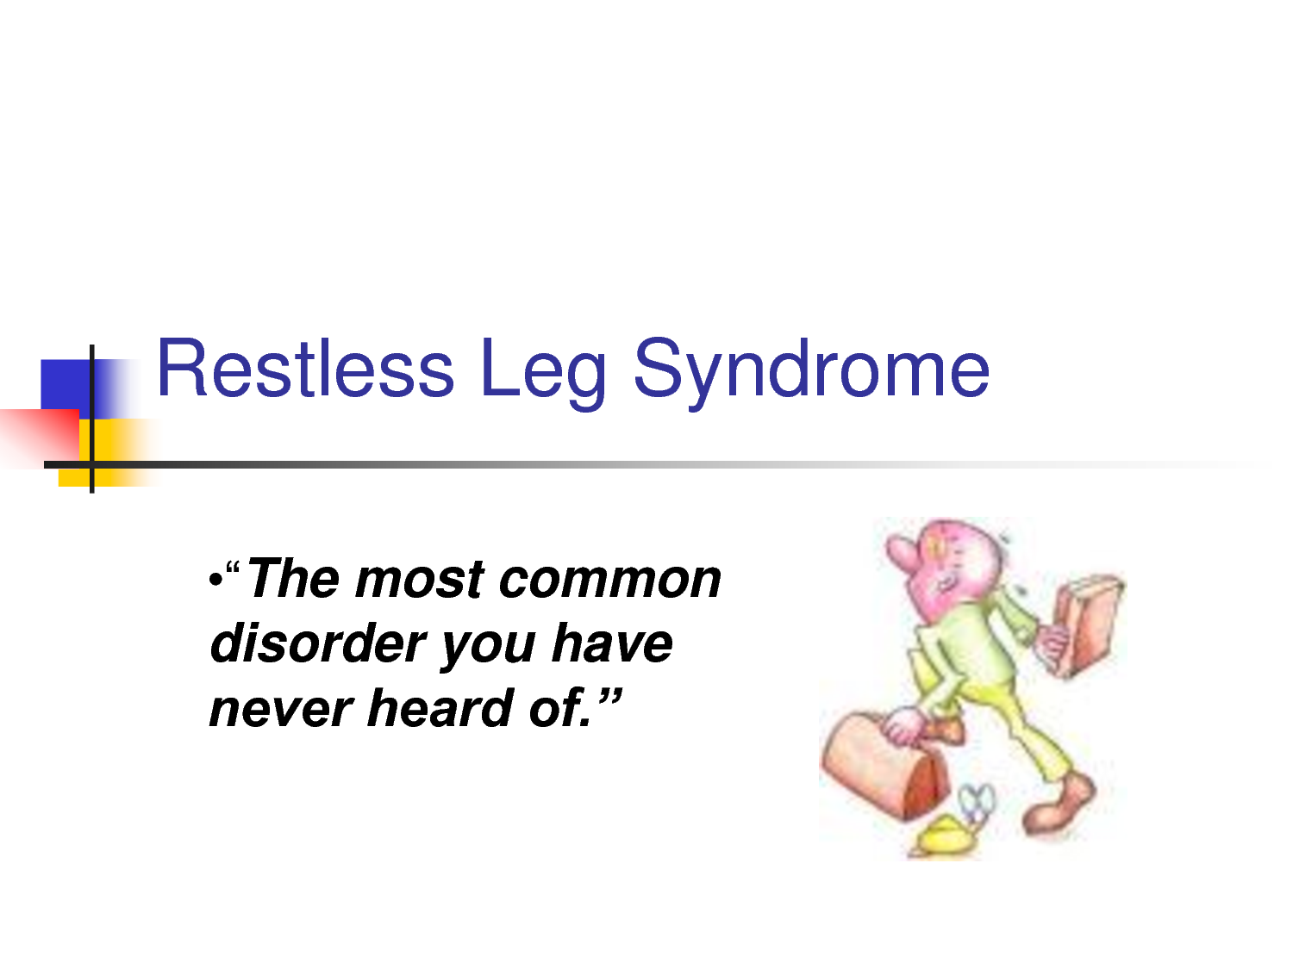

Slide 3
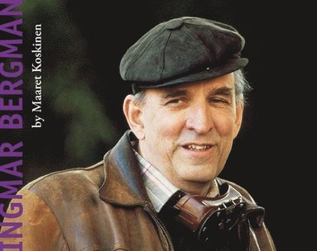

Slide 4
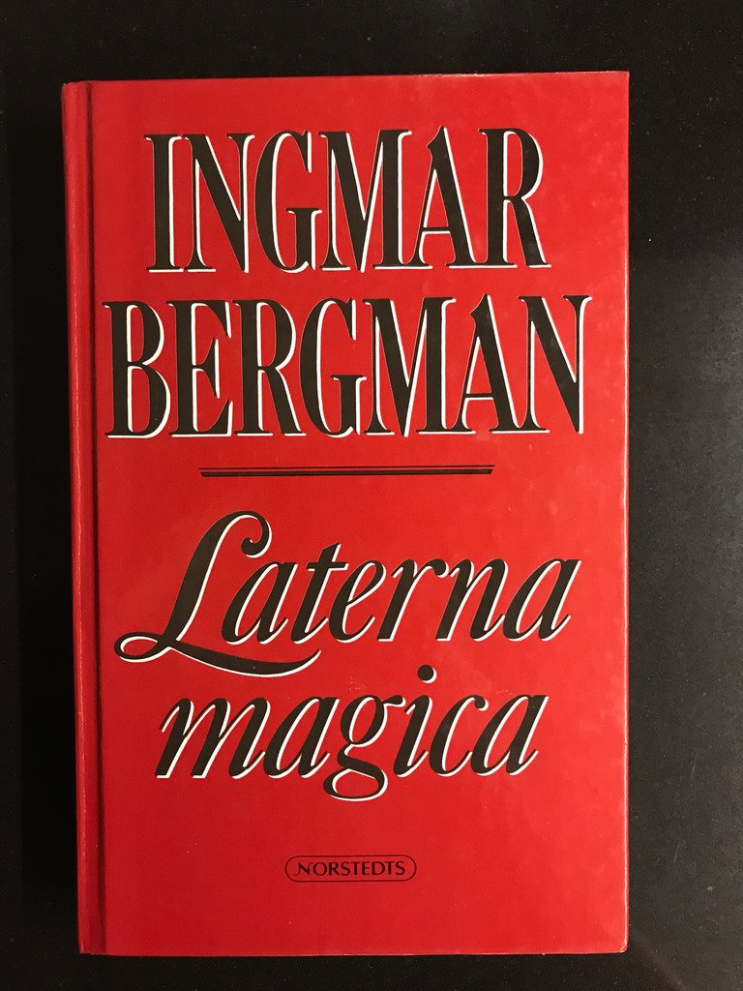

Slide 5
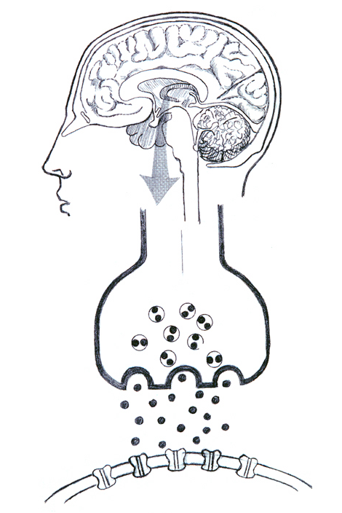
Synaps

Slide 6
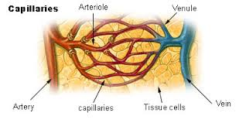

Slide 7
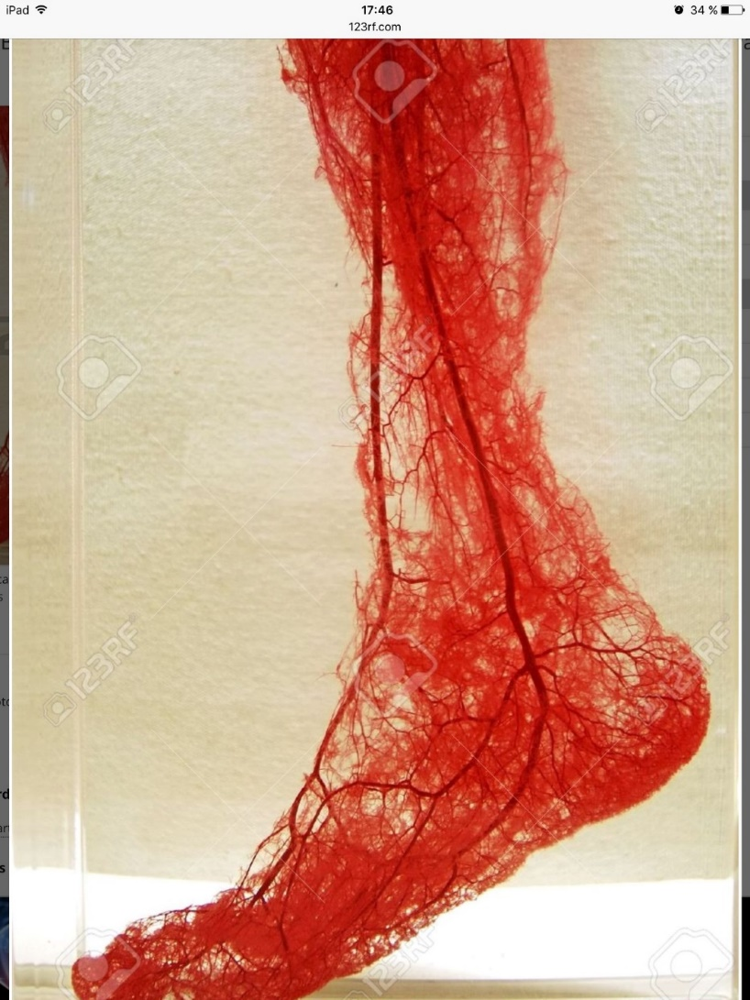
Wahlin-Larsson B. et al 2007

Slide 8
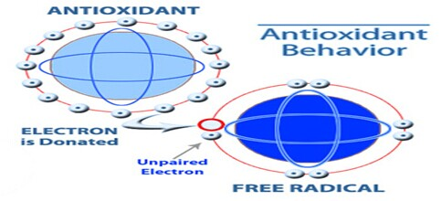
Oxidative stress and RLS
- Bascol G, Sleep Med. 2012

Slide 9
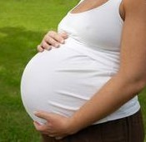

Slide 10
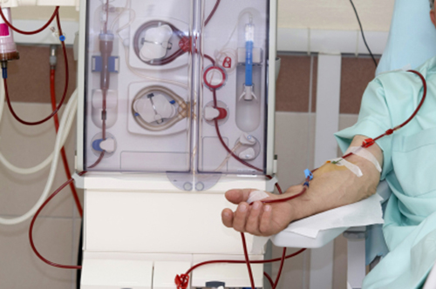

Slide 12
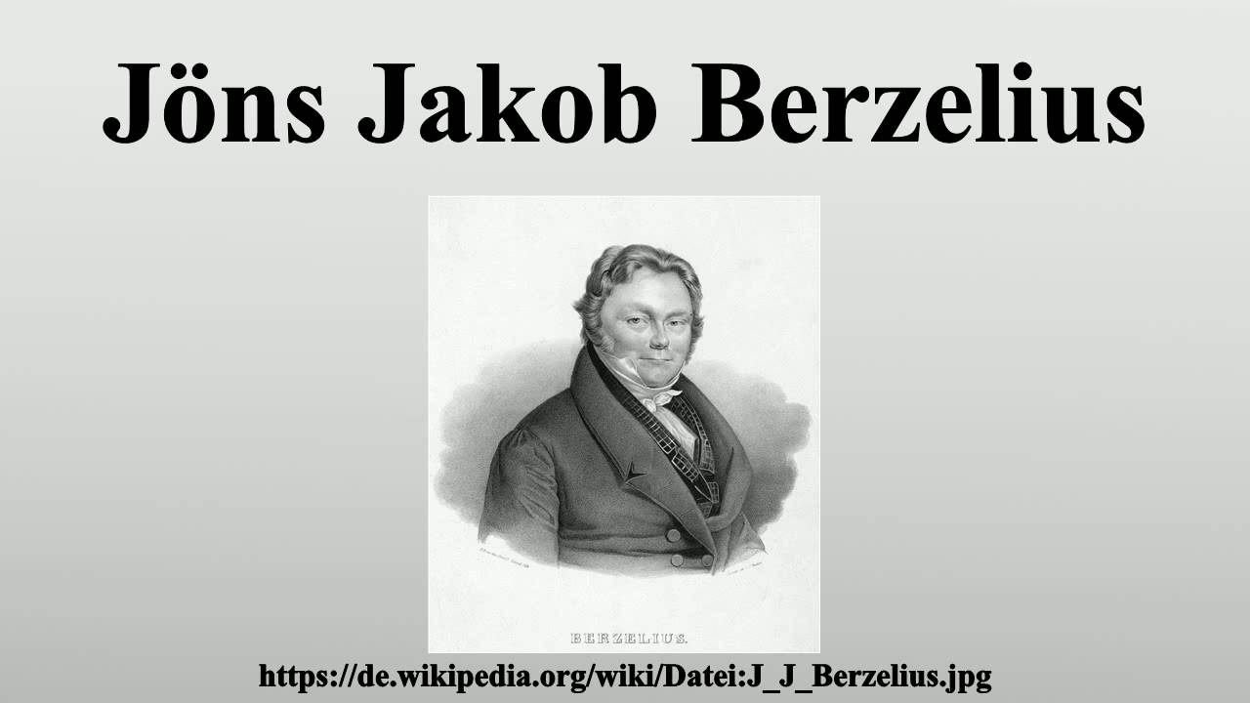

Slide 13
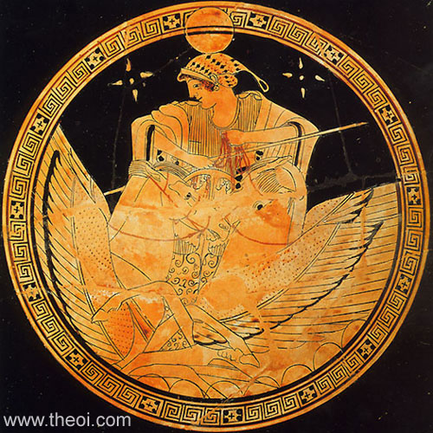

Slide 14
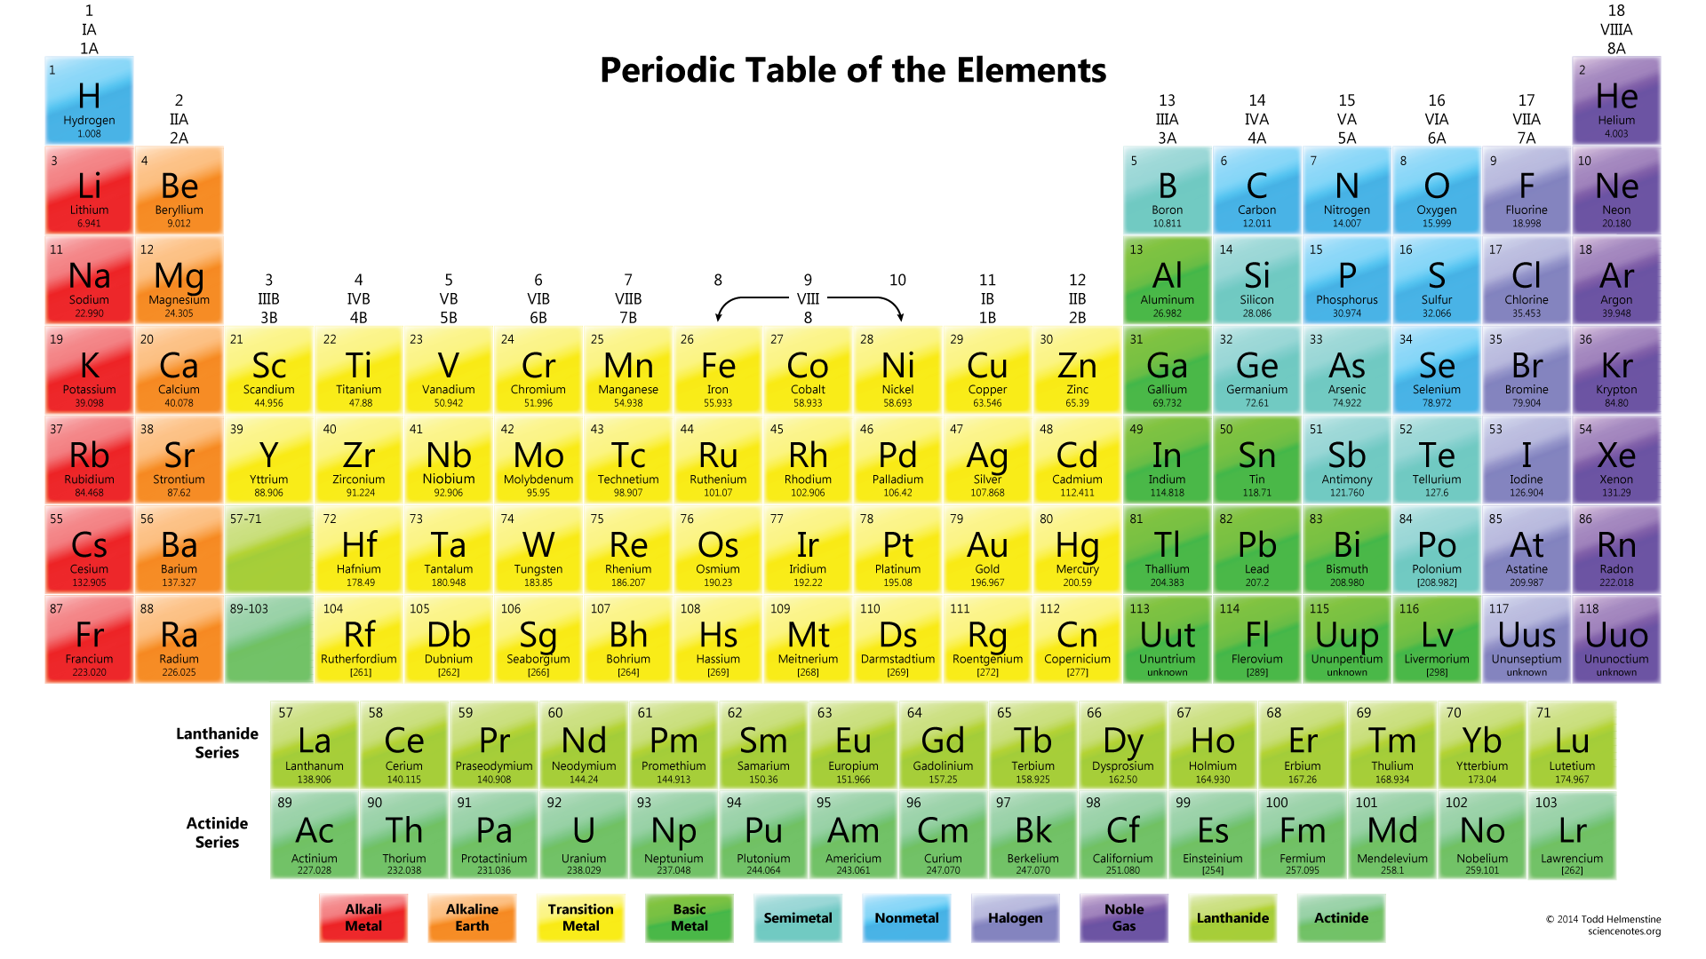

Slide 15
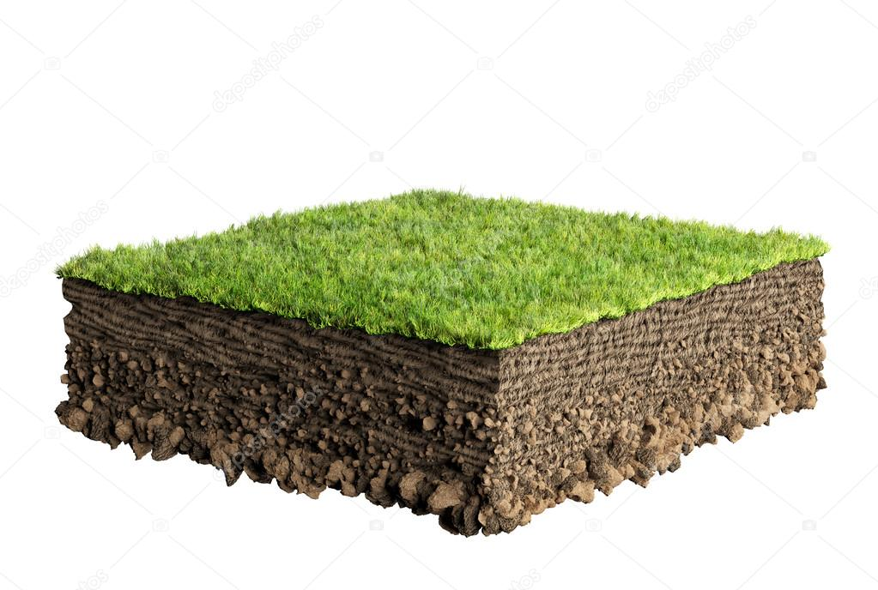
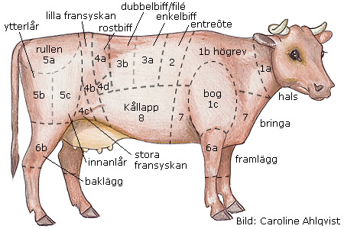
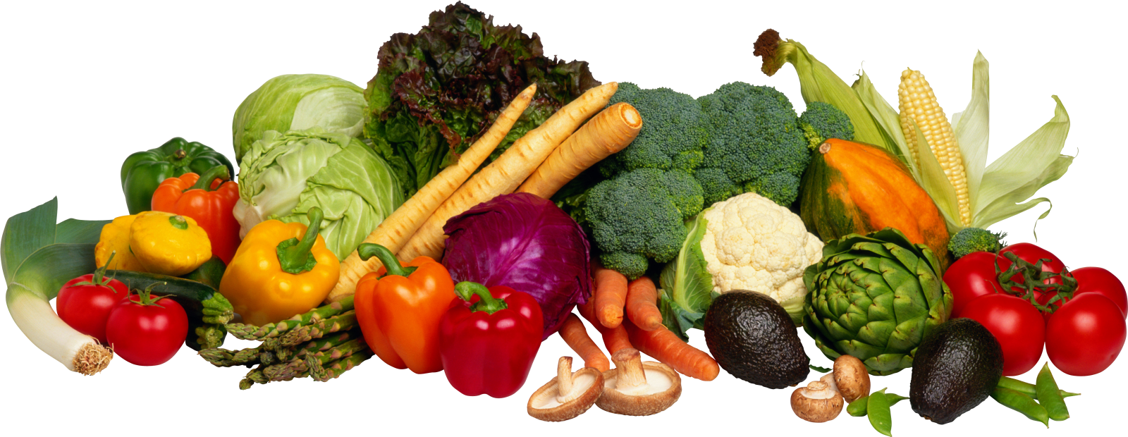

Slide 16
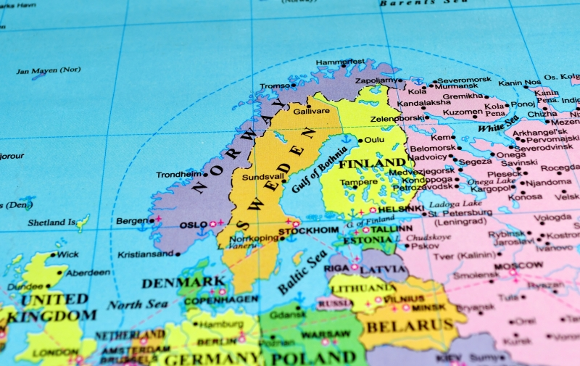

Slide 17
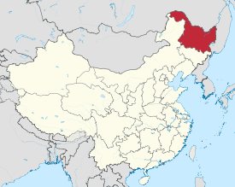

Slide 20
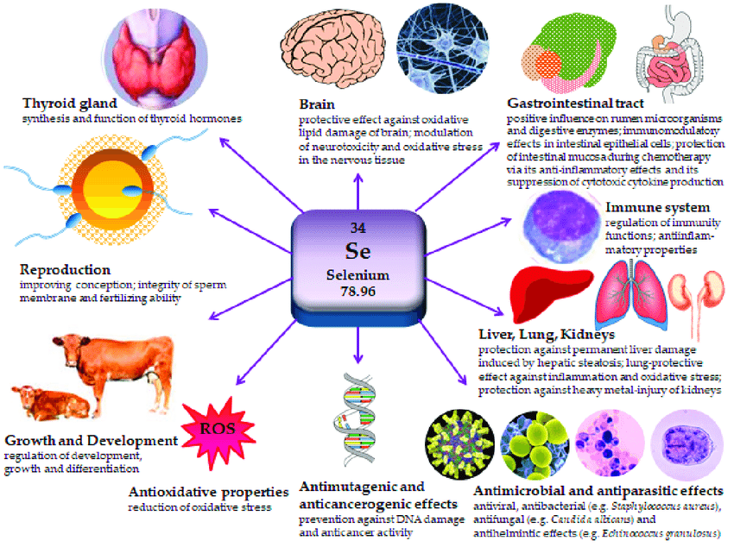

Slide 21
Function of selenium:
¤ A role in thyroid disease.
¤ Strong antioxidant
¤ May improve endothel function
¤ Affects dopamine system
¤ Improve immune system
¤ Improve spermiogenesis

Slide 22
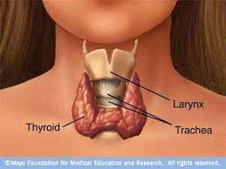
Iodine-independent risk factor for goiter. In Graves disease, selenium supplementation might facilitate biochemical restoration of euthyroidism and reduce ocular involvement. ( Rayman M, England )

Slide 23
Protection: Cardiovascular disease
Alehagen U et al. J Elem Med Biol. 2015
Alehagen U et al. J Elem Med Biol. 2020
Alehagen U et al. PLoS One, 2015
Alehagen U et al. PLoS One, 2016
Alehagen U et al. PLoS One, 2017
Alehagen U et al. PLoS One, 2018
Alehagen U et al. Biofactors 2018
Alehagen U et al. Int J Cardiol. 2013
Alehagen U et al. Int J Clin Nutr. 2016

Slide 24
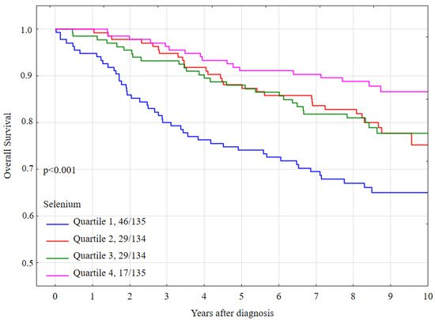
Serum Selenium Level Predicts 10-Year Survival after Breast Cancer. Szwiec et al. Nutritients, 2021

Slide 25
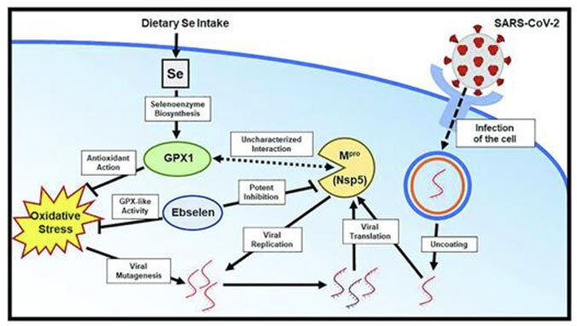
Se inside the cell

Slide 26
Immune system vs virus
In the literature: Relation to low selenium in: Influenza, HIV, Polio, Ebola, Coxsackie.
Covid-19:
Zhang J et al. Association between regional selenium status and
reported outcome of covid-19 cases in China. Am J Clin Nutr. 2020.
Moghaddam A et al. Selenium deficiency is associated with mortality
risk from covid-19. Nutritients, 2020.

Slide 27
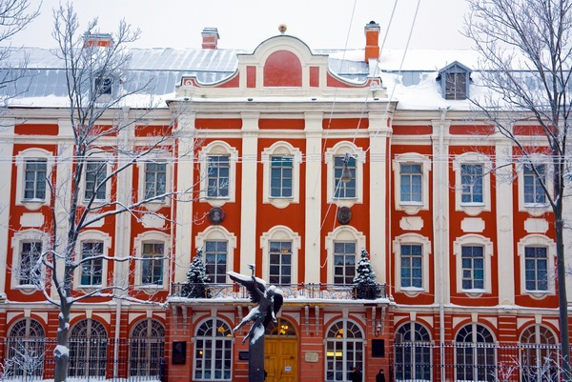
Review: Selenium and brain function:
Nikolay D. Solovyev, St Petersburg State University
Journal of Inorganic Biochemistry, 2015, 153: 1-12.

Slide 28
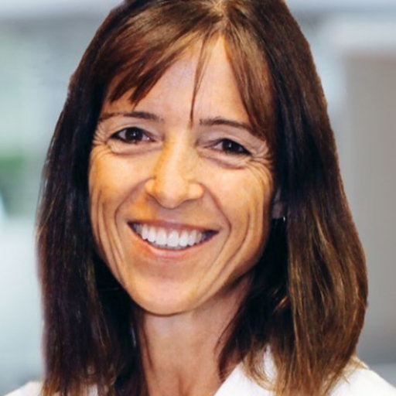
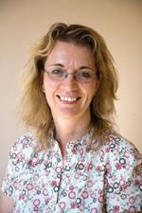
Ulfberg J, Stehlik R, Mitchell U. Treatment of restless legs syndrome/Willis Ekbom Disease with selenium.
Iran J Neurol. 2016;15:235-36.

Slide 29
Rajaran SS, Walters AS, England SJ, Mehta D, Nizan F.
Some children with growings pains may actually have restless legs syndrome.
Sleep 2004;27:767-73.

Slide 30
Selenium in ”Growing pains”
Brahme-Isgren et al, Läkartidningen, 1995
Selenium 50 mcg or placebo for 2 months in children, aged 3-12
0= none efficiency, 1= some efficiency, 2= good, 3= symptom free
P<0,01

Slide 31
Selenium 200 µg daily vs. Placebo during 1 month in 60 patients with RLS
International RLS symptom scale
P < 0,001
Rahimdel AG et al. Iranian Red Crescent Medical Journal. 2012; 14:14-19

Slide 32
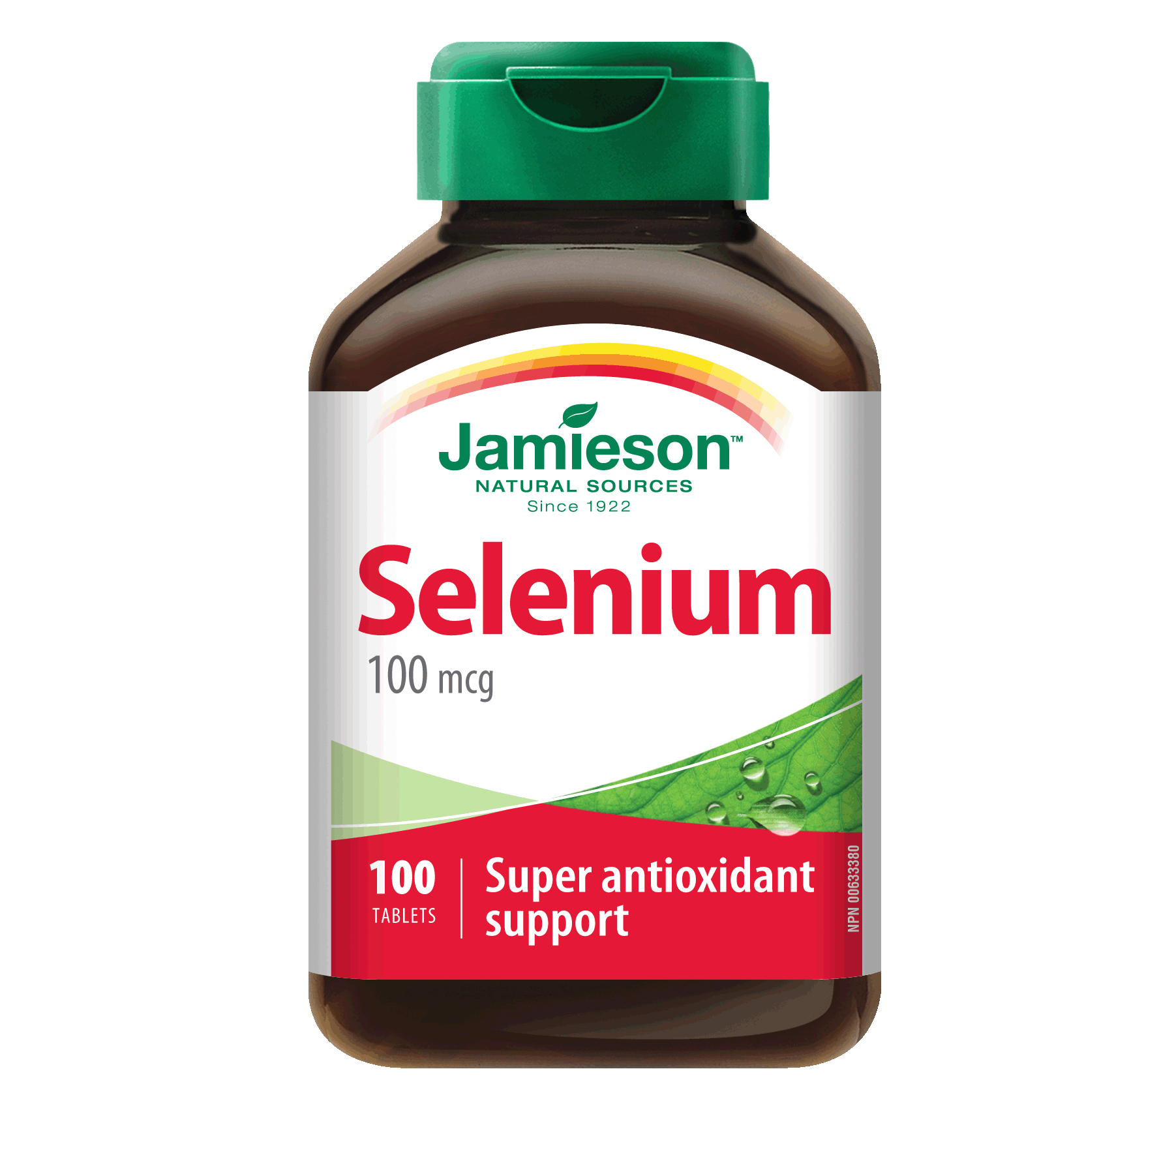
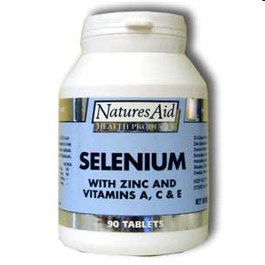
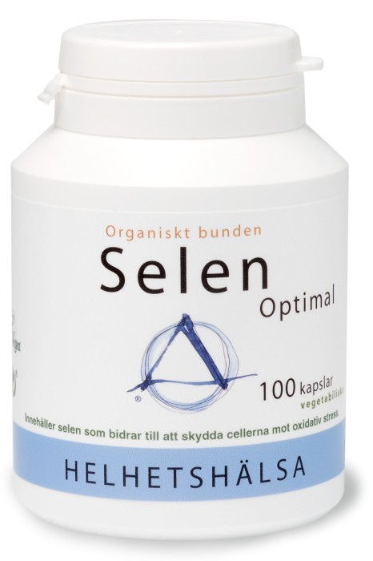
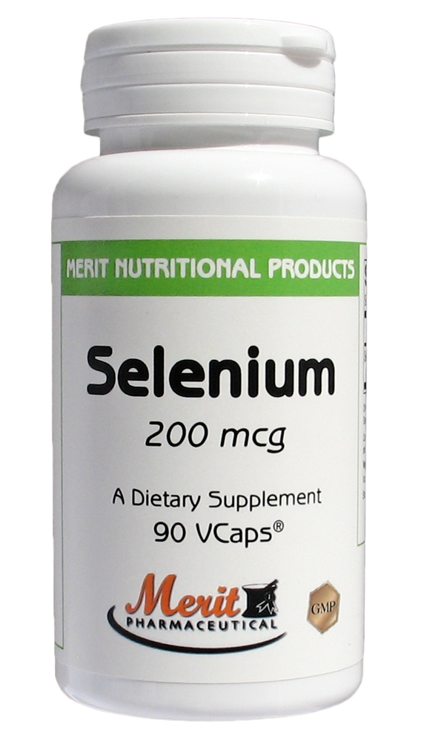
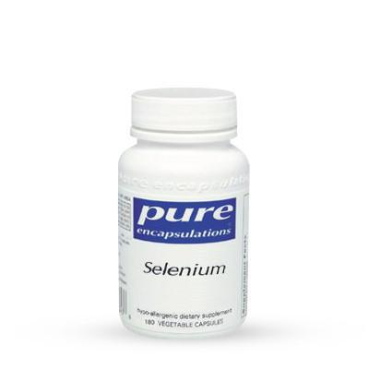
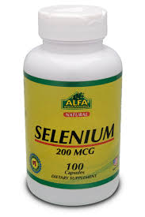

Slide 33
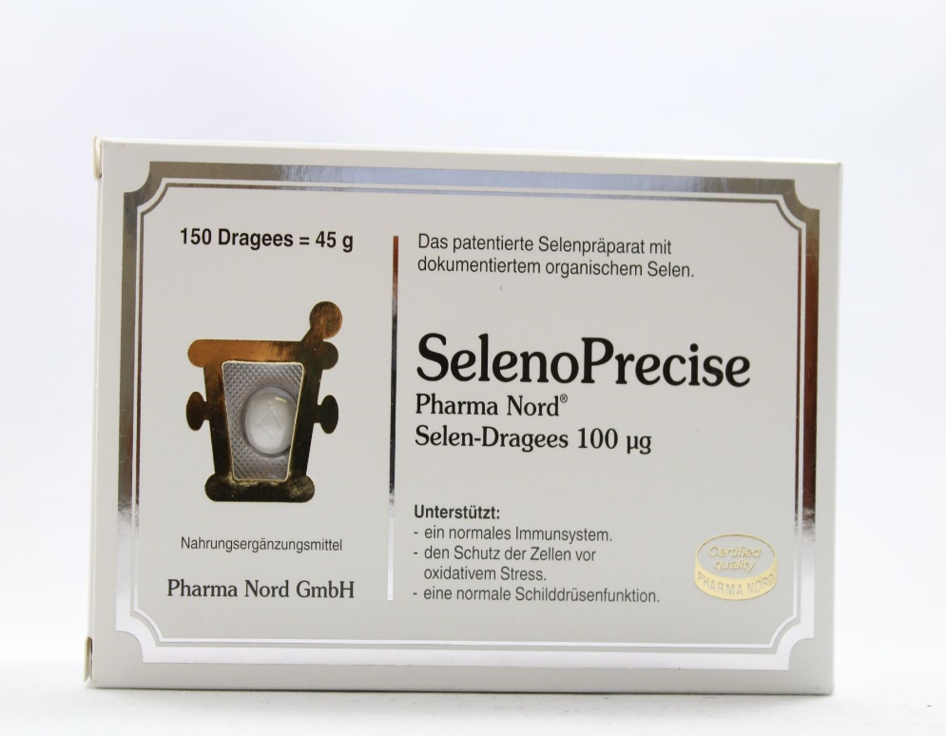
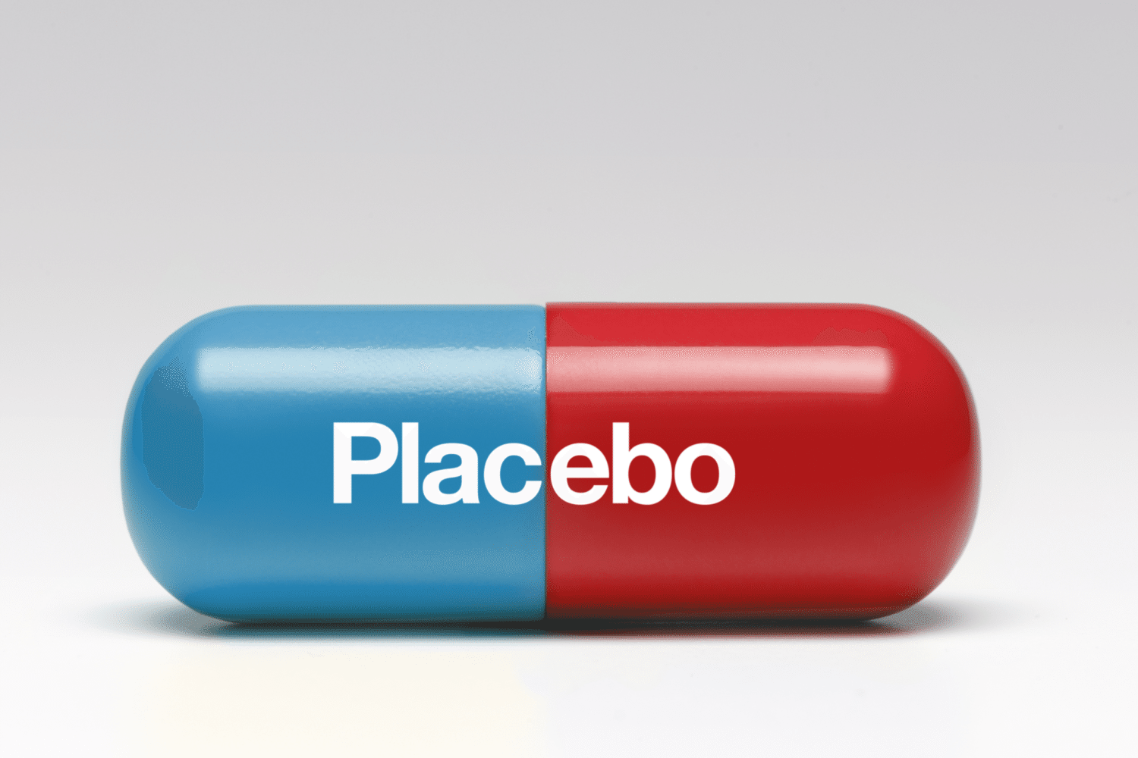
Selenium vs Placebo in RLS in an ongoing study in Avesta, Uppsala and Falun

Slide 34

Future projects:
Selenium in blood, hair or nails in different populations with RLS or non-RLS?
Selenium in pregnant women with RLS or non-RLS?
Selenium in RLS-patients with End Stage Renal Disease?
Selenium in PLMS?

Slide 35

Thank you!
jan.ulfberg@circad.se www.circad.se

